Slide 1
Best Practices and Sustainability in HPC Software Development
ATPESC 2020
Katherine Riley
Director of Science, Argonne Leadership Computing Facility Argonne National Laboratory
August 6, 2020

Slide 2

License, Citation and Acknowledgements
License and Citation
This work is licensed under a Creative Commons Attribution 4.0 International License (CC BY 4.0).
The requested citation the overall tutorial is: David E. Bernholdt, Anshu Dubey, Mark C. Miller, Katherine M. Riley, and James M. Willenbring, Software Productivity Track, in Argonne Training Program for Extreme Scale Computing (ATPESC), August 2020, online. DOI: 10.6084/m9.figshare.12719834
Individual modules may be cited as Speaker, Module Title, in Software Productivity Track…
Acknowledgements
Additional contributors include: Patricia Grubel, Rinku Gupta, Mike Heroux, Alicia Klinvex, Jared O’Neal, David Rogers, Deborah Stevens
This work was supported by the U.S. Department of Energy Office of Science, Office of Advanced Scientific Computing Research (ASCR), and by the Exascale Computing Project (17-SC-20-SC), a collaborative effort of the U.S. Department of Energy Office of Science and the National Nuclear Security Administration.
This work was performed in part at the Argonne National Laboratory, which is managed by UChicago Argonne, LLC for the U.S. Department of Energy under Contract No. DE-AC02-06CH11357.
This work was performed in part at the Oak Ridge National Laboratory, which is managed by UT-Battelle, LLC for the U.S. Department of Energy under Contract No. DE-AC05-00OR22725.
This work was performed in part at the Lawrence Livermore National Laboratory, which is managed by Lawrence Livermore National Security, LLC for the U.S. Department of Energy under Contract No. DE-AC52-07NA27344.
This work was performed in part at Sandia National Laboratories. Sandia National Laboratories is a multi-mission laboratory managed and operated by National Technology and Engineering Solutions of Sandia, LLC., a wholly owned subsidiary of Honeywell International, Inc., for the U.S. Department of Energy’s National Nuclear Security Administration under contract DE-NA0003525.

Slide 3
Good Scientific Process Requires Good Software Practices Good Software Practices Will Increase Science Productivity
Notes:
Putting Sustainability into the Practices bucket

Slide 4
Notes:
Engineering mistakes happen. They can be huge but of course they happen on smaller scales too.
Most engineering mistakes are not made on purpose.
Both of these are interesting because there was a disconnect between the experts and the politics.. But not all are
PROCESS matters. Of course, these has aspects of politics

Slide 5
Notes:
Y2K was because people did not plan for code lasting that long. Or it did not occur to them.

Slide 6
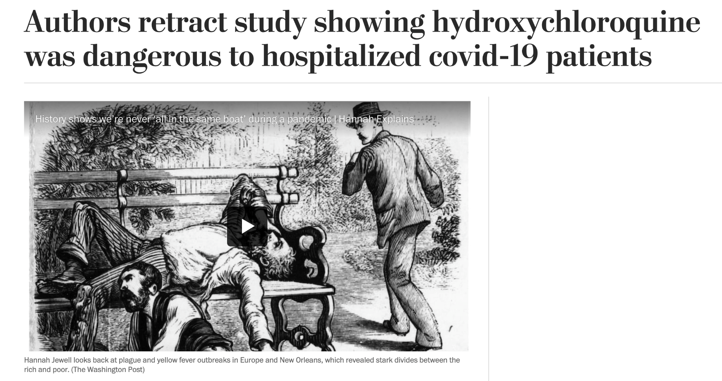
Notes:
The Mars Climate Orbiter was a satellite meant to collect data on Mars for two Earth years (about one Martian year) and act as a relay station for data from the Mars Polar Lander. Launched in December 1998, the Orbiter was set to arrive at the Red Planet later the next year. But on September 23, 1999, NASA announced the orbiter was lost.
The failure of NASA’s systems engineering, and the checks and balances in our processes, to detect the error.
UNITS PROBLEM between ground based software and the orbiter
This will happen – two different components of software, two physics models – you have to make sure you are talking apples and pples
Let’s connect this to your work – there are people here who are designing nuclear reactors, working on the design of million or billion dollar experiments, but also many are not. But all the lessons of best practices are still crucial for the scientific process and productive use of developer and compute time

Slide 7
Two major journals retract papers because data could not be validated. Lancet and NEJM. https://www.sciencemag.org/news/2020/06/two-elite-medical-journals-retract-coronavirus-papers-over-data-integrity-questions
Stanford antibody study attacked for statistics – not published, but a lot of splash
https://www.medrxiv.org/content/10.1101/2020.04.14.20062463v2
Notes:
https://www.washingtonpost.com/nation/2020/06/04/coronavirus-live-updates-us/
The Mars Climate Orbiter was a satellite meant to collect data on Mars for two Earth years (about one Martian year) and act as a relay station for data from the Mars Polar Lander. Launched in December 1998, the Orbiter was set to arrive at the Red Planet later the next year. But on September 23, 1999, NASA announced the orbiter was lost.
the failure of NASA’s systems engineering, and the checks and balances in our processes, to detect the error. UNITS PROBLEM between ground based software and the orbiter
Let’s connect this to your work – there are people here who are designing nuclear reactors, working on the design of million or billion dollar experiments, but also many are not. But all the lessons of best practices are still crucial for the scientific process and productive use of developer and compute time

Slide 8
rt
Notes:
This point is crucial. As the Director of Science for a supercomputing facility, I worry about the time on these systems being used productively.
100s of millions to build these systems
Millions to keep them running.
COMPARABLE TO LHC – the lifetime of the experimental facility is longer. Budget $9B – but over more than a decade. 200MW but does not run 365 days/year
Do Due diligence to do the best I can using these resources, using best practices as well as I can

Slide 9
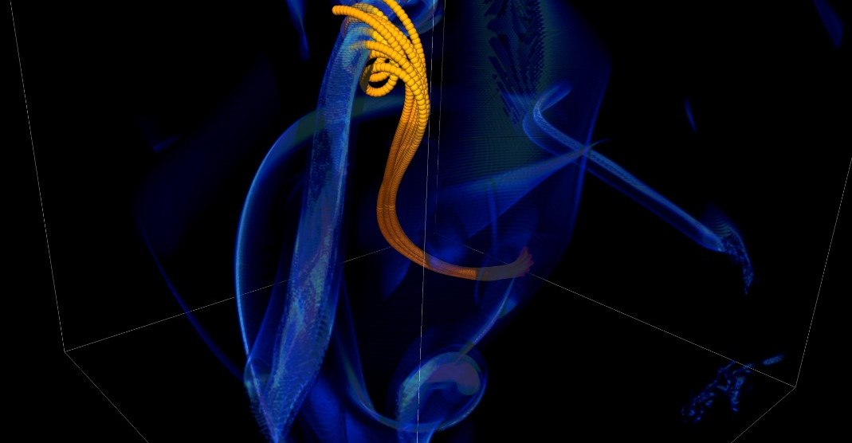
Mitigate Risk But It Is Never Zero
Short notice availability of one of the biggest machines of it’s time
< 1month to get ready, run was 1.5 weeks
Quick and dirty development of particle capability in code
Error in tracking particles resulted in duplicated tags from round-off
Had to develop post-processing tools to correctly identify trajectories
6 months to process results
FLASH had a software process in place. It was tested regularly. This was one instance when the full process could not be applied because of time constraints.
Notes:
2005, BG/L
This was not even a situation like retracting results

Slide 10
Understand Limitations
Good and bad science can be done with simple models
Are the numerics and stability understood?
Is it statistically sound?
Is it reproducible? Is the data sound?
The more complex a model(s), the easier it is to make an incorrect assumption
… and many more …
Notes:
The more complex things get the more likely you can make an error – assuming units are one thing, when they are really something different. Process, sustainability, can help there

Slide 11
Software Practices and Sustainability are Tightly Coupled
Software Sustainability
Software Practices
Notes:
I inundated you with errors and maybe that is closely tied to software practices, but what
Good Scientific Process Requires Good Software Practices
Good Software Practices Will Increase Science Productivity
Good Software Practices can Improve Software Sustainability
Software Sustainability will also increase Science Productivity
Good practices are process and can increase productivity and sustainability

Slide 12
Improve Developer Productivity and Software Sustainability
Establish software communities
Determine community policies to improve software quality and compatibility
Create Software Development Kits (SDKs) to facilitate the combined use of complementary libraries and tools
1
Customize and curate methodologies
Target scientific software productivity and sustainability
Use workflow for best practices content development
3
Incrementally and iteratively improve software practices
Determine high-priority topics for improvement and track progress
Productivity and Sustainability Improvement Planning (PSIP)
Engage in community outreach
Broad community partnerships
Collaboration with computing facilities
Webinars, tutorials, events
WhatIs and HowTo docs
Better Scientific Software site (https://bssw.io)
2
4
Notes:
Not just an issue of telling you to do these things.
An infrastructure of support
Rebuild CERN? That is big and expensive. So are codes.

Slide 13
Objectives of the Session
Good software practices are important for scientific productivity, quality, and reliability of computational science
Challenges are increasing
Help CSE researchers increase effectiveness as well as leverage and impact
Facilitate CSE collaboration via software in order to advance scientific discoveries
Your code will live longer than you expect.
Prepare for this.
Your science campaigns have real costs.
Think of the consequences.

Slide 14
Agenda
Time (Central TZ) | Module | Topic | Speaker
9:30am-9:45am | 00 | Introduction | David E. Bernholdt, ORNL
9:45am-10:15am | 01 | Overview of Best Practices in HPC Software Development | Katherine M. Riley, ANL
10:15am-10:45am | 02 | Agile Methodologies | James M. Willenbring, SNL
10:45am-11:00am | 03 | Git Workflows | James M. Willenbring, SNL
11:00am-11:15am |  | Break (and Q&A with speakers)
11:15am-12:00pm | 04 | Software Design | Anshu Dubey, ANL
12:00pm-12:45pm | 05 | Software Testing | Anshu Dubey, ANL
12:45pm-1:45pm |  | Lunch (and Q&A with speakers)
1:45pm-2:00pm | 06 | Agile Methodologies Redux | James M. Willenbing, SNL
2:00pm-3:00pm | 07 | Refactoring | Anshu Dubey, ANL
3:00pm-3:15pm |  | Break (and Q&A with speakers)
3:15pm-3:45pm | 08 | Continuous Integration | Mark C. Miller, LLNL
3:45pm-4:30pm | 09 | Reproducibility | David E. Bernholdt, ORNL
4:30pm-4:45pm | 10 | Summary | David E. Bernholdt, ORNL

Slide 15
Heroic Programming
Usually a pejorative term, is used to describe the expenditure of huge amounts of (coding) effort by talented people to overcome shortcomings in process, project management, scheduling, architecture or any other shortfalls in the execution of a software development project in order to complete it. Heroic Programming is often the only course of action left when poor planning, insufficient funds, and impractical schedules leave a project stranded and unlikely to complete successfully.
From http://c2.com/cgi/wiki?HeroicProgramming
Science teams often resemble heroic programming
Many do not see anything wrong with that approach
Notes:
Heroic – How things have been done for a very long time
Leading to everyone coming up with their own solution
Anecdote about offer to help with the development and get told a postdoc will do it because this is what we do.

Slide 16
What is wrong with heroic programming
Scientific results that could be obtained with heroic programming have run their course, because:
It is not possible for a single person to take on all these roles
Better scientific understanding
Math model
More Complex Computers
More complex software
Numerics
Different roles
and responsibilities
Verification
Emerging New Approaches to Science
Performance

Slide 17
In Extreme-Scale science
Codes aiming for higher fidelity modeling and new modeling
More complex codes, simulations and analysis
More moving parts that need to interoperate
Variety of expertise needed – the only tractable development model is through separation of concerns
It is more difficult to work on the same software in different roles without a software engineering process
Complexity of workflows and of computational approaches
Onset of higher platform heterogeneity
Requirements are unfolding, not known a priori
The only safeguard is investing in flexible design and robust software engineering process
Notes:
These changes are even harder in extreme scale sciences –

Slide 18
In Extreme-Scale science
Codes aiming for higher fidelity modeling
More complex codes, simulations and analysis
More moving parts that need to interoperate
Variety of expertise needed – the only tractable development model is through separation of concerns
It is more difficult to work on the same software in different roles without a software engineering process
Complexity of workflows and of computational approaches
Onset of higher platform heterogeneity
Requirements are unfolding, not known a priori
The only safeguard is investing in flexible design and robust software engineering process
Computers change fast
Notes:
Supercomputers changing fast – you need to have a code dealing with that kind of change. Don’t just relax thinking we are GPUs for a long time and it will be easy.

Slide 19
Technical Debt
Consequence of Choices
Quick and dirty collects interest which means more effort required to add features
Thoughtful solutions that are limited in applicability
Accretion leads to unmanageable software
Increases cost of maintenance
Parts of software may become unusable over time
Inadequately verified software produces questionable results
Increases ramp-on time for new developers
Reduces software and science productivity due to technical debt

Slide 20
"... it seems likely that signiﬁcant software contributions to existing scientiﬁc software projects are not likely to be rewarded through the traditional reputation economy of science. Together these factors provide a reason to expect the over-production of independent scientiﬁc software packages, and the underproduction of collaborative projects in which later academics build on the work of earlier ones."
Howison & Herbsleb (2011)

Slide 21
Software Process Best Practices
Baseline
Desirable
Invest in extensible code design
Use version control and automated testing
Institute a rigorous verification and validation regime
Define coding and testing standards
Clear and well-defined policies for
Auditing and maintenance
Distribution and contribution
Documentation
Provenance and reproducibility
Lifecycle management
Open development and frequent releases

Slide 22
Challenges Developing a Scientific Application
Technical
Sociological
All parts of the cycle can be under research
Requirements change throughout the lifecycle as knowledge grows
Verification complicated by floating point representation
Real world is messy, so is the software
Competing priorities and incentives
Limited resources
Perception of overhead without benefit
Need for interdisciplinary interactions

Slide 23
Consider During This Track
What risks/challenges are you currently facing?
What practices might be easier to start in your development process?
What choices are made in your application out of momentum vs planning?
What support would you need for a more challenging change?
If you consider software changes, are you considering the new risks?
Notes:
This is risk assessment really, and minimizing risk.

Slide 24
Questions

Slide 25
Agenda
Time (Central TZ) | Module | Topic | Speaker
9:30am-9:45am | 00 | Introduction | David E. Bernholdt, ORNL
9:45am-10:15am | 01 | Overview of Best Practices in HPC Software Development | Katherine M. Riley, ANL
10:15am-10:45am | 02 | Agile Methodologies | James M. Willenbring, SNL
10:45am-11:00am | 03 | Git Workflows | James M. Willenbring, SNL
11:00am-11:15am |  | Break (and Q&A with speakers)
11:15am-12:00pm | 04 | Software Design | Anshu Dubey, ANL
12:00pm-12:45pm | 05 | Software Testing | Anshu Dubey, ANL
12:45pm-1:45pm |  | Lunch (and Q&A with speakers)
1:45pm-2:00pm | 06 | Agile Methodologies Redux | James M. Willenbing, SNL
2:00pm-3:00pm | 07 | Refactoring | Anshu Dubey, ANL
3:00pm-3:15pm |  | Break (and Q&A with speakers)
3:15pm-3:45pm | 08 | Continuous Integration | Mark C. Miller, LLNL
3:45pm-4:30pm | 09 | Reproducibility | David E. Bernholdt, ORNL
4:30pm-4:45pm | 10 | Summary | David E. Bernholdt, ORNL

